Slide 1
Time Series Analysis
Elsayed Hemayed
The original slides are from Slideshare developed by Derek Kane, a Data scientist and also EMC Data Analytics Course

Slide 2
Overview of Topics
Time Series Analysis and its applications in forecasting
Time Series Decomposition
ARIMA Model
Reasons to Choose (+) and Cautions (-) with Time Series Analysis
Time Series Analysis with R

Slide 3
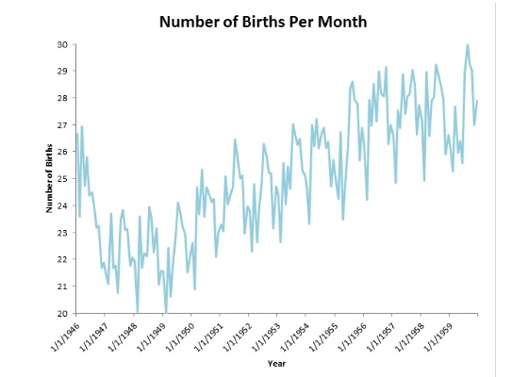
Time Series Analysis

Slide 4
Importance of Time Series
The ability to observe the development of an area of interest (over time) and make predictions based upon historical observations creates a competitive advantage within the analytics based 21st century global business environment.
Example: If an organization has the capability to better forecast the sales quantities of a product, they will be in a more favorable position to structure procurement and optimize inventory levels. This can result in an increased liquidity of the organization’s cash reserves, decrease of working capital, and improved customer satisfaction through increased order fulfillment and decreased backorders.
Additionally, the senior management can formulate the entire capacity planning (fiscal sales budget) of the organization through better prediction of revenue (including costs & profit margin). Head Count, Capex and R&D expenditures, marketing budgets, all rely upon having a proper sales budget and time series predictions are the backbone of a successful organization.

Slide 5
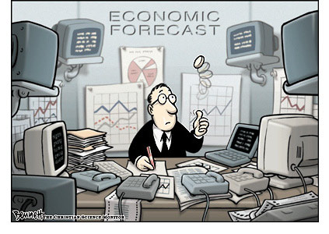
Use Cases
Forecast next month's sales
Based on last few months
Forecast tomorrow's stock price
Based on last few days
Forecast power demand in the near term
Based on last few days
Notes:
The key area of application of Time Series Analysis is in forecasting.
Economic and business planning, inventory and production control. Control and optimization of industrial processes are some of the key applications in which time series analysis is deployed.
Time Series data provide useful information about the physical, biological, social or economic systems generating the time series, such as:
Economics/ Finance: share prices, profits, imports, exports, stock exchange indices.
Sociology: school enrollments, unemployment, crime rate.
Environment: Amount of pollutants, such as suspended particulate matter (SPM), in the environment.
Meteorology: Rainfall, temperature, wind speed.
Epidemiology: Number of SARS cases over time.
Medicine: Blood pressure measurements over time for evaluating drugs to control hypertension.

Slide 6
Time Series Analysis
What will our December sales be
(based on the sales of the last few months)?
Time Series Analysis accounts for the internal structure of measurements taken over time
Trend
Seasonality
Cycles
Irregular
Time series: Ordered sequence of numerical values, measured over equally spaced time intervals
The goal can be to identify the internal structure, or to forecast near-future events based on recent history
Our Example: Box-Jenkins Methods (ARMA, ARIMA)
Notes:
Businesses perform sales forecasting to look well ahead in order to plan their investments, launch new products, decide when to close or withdraw products and so on. The sales forecasting process is a critical one for most businesses. One of the inputs to the sales forecasting process is to look into the past. How well did we do in the last few months or what were our sales in the same time period for he last few years? Time Series Analysis provides a scientific methodology for sales forecasting.Time Series Analysis is the analysis of data organized across units of time. Time series is a basic research design in which data for one or more variables are collected for many observations at different time periods. The main objectives in Time Series Analysis are:
To understand the underlying structure of the time series by breaking it down to its components.
Fit a mathematical model and then proceed to forecast the future
The time periods are usually regularly spaced and the observations may be either univariate or multivariate. Univariate time series are those where only one variable is measured over time, whereas multiple time series are those, where multiple variables are measured simultaneously. The internal structure of the data may specify a trend, seasonality or cycles:
<Continued>

Slide 7
Modeling a Time Series
Let's model the time series as
Y_{t} =T_{t} +S_{t} +R_{t}, t=1,...,n.
T_{t}: Trend term
Sales of iPads steadily increased over the last few years: trending upward.
S_{t}: The seasonal term (short term periodicity)
Retail sales fluctuate in a regular pattern over the course of a year.
Typically, sales increase from September through December and decline in January and February.
R_{t}: Random fluctuation
Noise, or regular high frequency patterns in fluctuation
Notes:
We present a simple model for the time series with the trend, seasonality and a random fluctuation. There is often a low frequency cyclic term as well, but we are ignoring that for simplicity.
Examples of trend and seasonality are also detailed in the slide

Slide 8
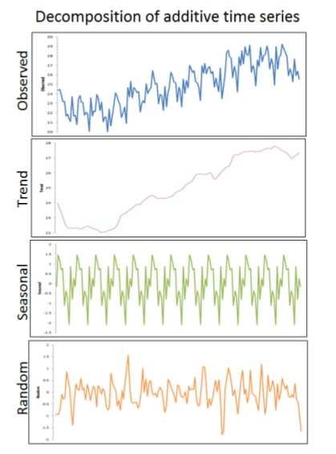
Decomposition Basics
The shown example can be spilt into fundamental components:
Seasonality
Trend
Random fluctuations in the data (irregular components).
Notes:
Trend component - Trend is a long term movement in a time series. It is the underlying direction (upward or downward) and rate of change in a time series, when allowance has been made for the other components.
Seasonal component - Seasonal fluctuations of known periodicity. It is the component of variation in a time series which is dependent on the time of the year. It describes any regular fluctuations with a period of less than one year. For example, the costs of various types of fruits and vegetables, and average daily rainfall, all show marked seasonal variation.
Cyclic component - Cyclical variations of non-seasonal nature, whose periodicity is un-known.
Irregular component - Random or chaotic noisy residuals left over when other components of the series (trend, seasonal and cyclical) have been accounted for.
Trend and seasonality, though conceptually distinct, are essentially entangled. The value of the series at time t essentially depends on its value at time t−1, with the result that trend and periodic components are inextricably mixed. Hence, it is not possible to isolate one without trying to isolate the other.
In this lesson we will primarily focus on one Time Series Analysis methodology known as the “Box-Jenkins” method.

Slide 9
Decomposition - Seasonality
Seasonal Effects:
a systematic and calendar related effect.
Examples: sharp escalation in most Retail series around December in the Christmas period,
An increase in water consumption in summer due to warmer weather.
Seasonal adjustment:
the process of estimating and then removing from a time series influences that are systematic and calendar related.
Observed data needs to be seasonally adjusted as seasonal effects can conceal both the true underlying movement in the series.
Seasonality in a time series can be identified by regularly spaced peaks and troughs which have a consistent direction and approximately the same magnitude every year, relative to the trend.

Slide 10
Decomposition – Trend & Irregular
A trend can be defined as the 'long term' movement in a time series without calendar related and random (irregular) effects and is a reflection of the underlying level.
The irregular component (sometimes also known as the residual) is what remains after the seasonal and trend components of a time series have been estimated and removed. It results from short term fluctuations in the series which are neither systematic nor predictable.
In a highly irregular series, these random fluctuations can dominate movements, which will mask the trend and seasonality.

Slide 11
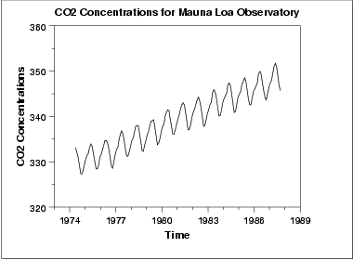
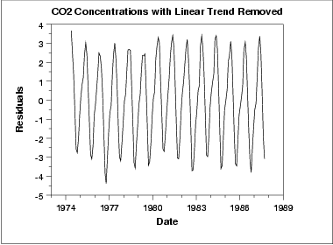
De-trending
In this example, we see a linear trend, so we fit a linear model
T*_{t} = mY_{t} + b
The de-trended series is then
Y¹_{t} = Y_{t} – T*_{t}
In some cases, may have to fit a non-linear model
Quadratic
Exponential
Notes:
Trend in a time series is a slow, gradual change in some property of the series over the whole interval under investigation.
De-trending is often applied to remove a feature thought to distort or obscure the relationships of interest.
In the example shown, the graph of CO2 concentrations measured over many years shows a linear upward trend. In climatology, for example, this CO2 trend due to urban warming might obscure a relationship between air temperature and CO2 concentration.
De-trending is a pre-processing step to prepare time series for analysis by methods that assume stationarity.
A simple linear trend can be removed by subtracting a least-squares-fit straight line. In the example shown we fit a linear model and obtain the difference. The graph shown next is a de-trended time series.
More complicated trends might require different procedures such a fitting a non-linear model such as a quadratic or a exponential model.
Use a Linear Trend Model if the first differences are more or less constant [ (y₂-y₁) = (y₃-y₂) = ……. = (y_{n}-y_{n-1}) ]
Use a Quadratic Trend Model if the second differences are more or less constant. [ (y₃-y₂) – (y₂-y₁) = ………= (y_{n}-y_{n-1})-(y_{n-1}-y_{n-2}) ]
Use an Exponential Trend Model if the percentage differences are more or constant. [ ((y₂-y₁) /y₁ ) * 100% = …….((y_{n}-y_{n-1})/y_{n-1} ) * 100%

Slide 12
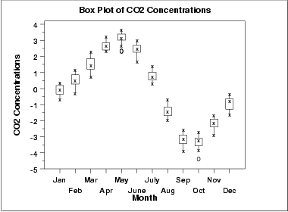
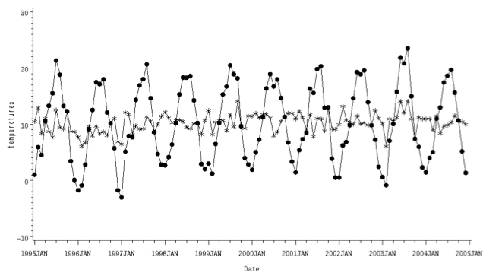
Seasonal Adjustment
Often, we know the "season"
For both retail sales and CO2 concentration, we can model the period as being a year, with variation at the month level
Simple ad-hoc adjustment: take several years of data, calculate the average value for each month, and subtract that from Y¹_{t}
Y²_{t} = Y¹_{t} – S*_{t}
Notes:
Unlike the trend and cyclical components, seasonal components, theoretically, happen with similar magnitude during the same time period each year.
The holiday sales spike is an example of seasonality. The seasonal component of a series typically makes the interpretation of a series ambiguous. By removing the seasonal component, it is easier to focus on other components.
A simple adjustment for seasonality is done with taking several years of data, calculating average value for each month and subtracting them from the actual value.

Slide 13
Box-Jenkins: What is it?
Used for predicting the next few observations in a time series, based on the last few observations.
Input: Trend and Seasonally-adjusted time series
Output: Expected future value of the time series
Applies ARMA (Autoregressive Moving Averages) and ARIMA (Autoregressive Integrated Moving Averages) model
Notes:
Box Jenkins methodology developed by Professors G.E.P. Box and G.M. Jenkins, enables the forecasting with time series data with both high accuracy and low computational requirements.
The technique may be applied to quickly determine forecasts that are as uncomplicated in form as the simple smoothing methods, or that involve a number of economic variables. In either case, use of this technique enables efficient utilization of other predictive information contained in the data. It offers assurance of obtaining the highest forecasting accuracy possible in terms of the variables on which the forecast is based.
The input for the model is the trend and seasonality adjusted time series and the output is the expected future value of the time series.
Box Jenkins Methodology applies autoregressive moving average ARMA or ARIMA models to find the best fit of a time series to past values of this time series, in order to make forecasts.

Slide 14
Stationary Sequences
Many time series analyses (Basic Box-Jenkins in particular) assume stationary sequences:
Mean, variance and autocorrelation structure do not change over time
In practice, this often means you must de-trend and seasonally adjust the data
ARIMA in principle can make the data (more) stationary with differencing
Notes:
A Stationary sequence is a random sequence in which the joint probability distribution does not vary over time. In other words the mean, variance and auto correlations do not change in the sequence over time.
In order to render a sequence stationary we need to remove the effects of trend and seasonality. The ARIMA model (implemented with Box Jenkins) uses the method of differencing to render the data stationary.

Slide 15
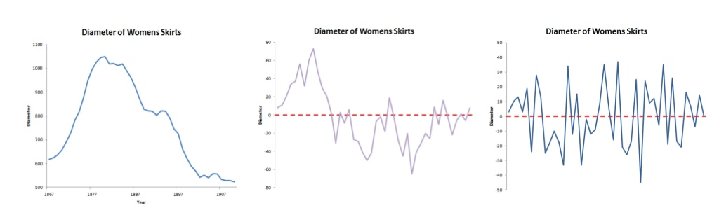
Differencing a Time Series
ARIMA models are defined for stationary time series. Therefore, if you start off with a non- stationary time series, you will first need to ‘difference’ the time series until you obtain a stationary time series.
If you have to difference the time series d times to obtain a stationary series, then you have an ARIMA(p,d,q) model, where d is the order of differencing used.
Original Dataset difference = 1 Difference =2
ARIMA(p,2,q) can be used

Slide 16
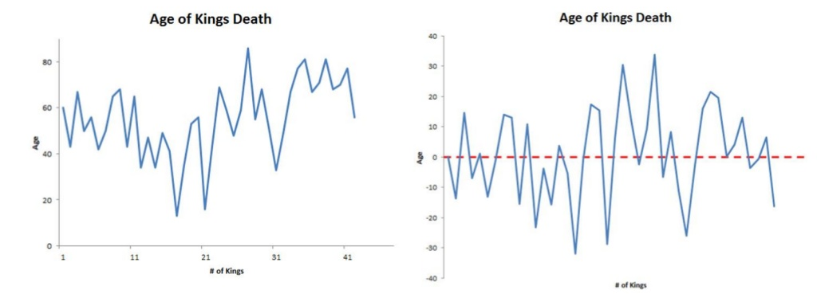
Another Differencing Example
Another example is the time series of the age of death of the successive kings of England:
Original Dataset difference = 1
ARIMA(p,1,q) can be used

Slide 17
ACF & PACF
Auto Correlation Function (ACF)
Correlation of the values of the time series with itself
Similarity of the observations as a function of time
Autocorrelation "carries over"
if X_{t} is correlated with X_{t-1}, it is also correlated with X_{t-2} (though to a lesser degree) (determines q)
Partial Auto Correlation Function (PACF)
The partial autocorrelation at lag k that is not explained by "carry over“
Helps determining the order of autoregressive models
Where does PACF go to zero? (determines p)
Notes:
A common assumption in many time series techniques is that the data are stationary. A stationary process has the property that the mean, variance and autocorrelation structure do not change over time.
An ACF plot provides an indication of the stationarity of the data. If the time series is not stationary, we can often transform it to stationarity with the simple technique of differencing.
PACF - The partial autocorrelation at lag k is the autocorrelation between X_{t} and X_{t-k} that is not accounted for by lags 1 through k-1.
One looks for the point on the plot where the partial autocorrelations for all higher lags are essentially zero.
We will look into ACF and PACF graphs in the next Lab.

Slide 18
ARMA Model
The simplest Box-Jenkins Model
Combination of two process models
Autoregressive: Y_{t} is a linear combination of its last p values
Moving average: Y_{t} is a constant value plus the effects of a dampened white noise process over the last q time steps
Notes:
Autoregressive (AR) models can be coupled with moving average (MA) models to form a general and useful class of time series models called Autoregressive Moving Average (ARMA) models. This is the simplest Box-Jenkins model.
AR model predicts y_{t} as a linear combination of its last p values. An autoregressive model is simply a linear regression of the current value of the series on one or more prior values of the same series. Several options are available for analyzing autoregressive models, including standard linear least squares techniques. They also have a straightforward interpretation.
The time series y is called an autoregressive process of order p and is denoted as AR(p) process.
A MA model adds to y_{t} the effects of a dampened white noise process over the last q steps. This is a simple moving average or single moving average; it's probably the most basic of the forecasting methods.
What one does is to take the data from the last n periods, average the data, and use that as the forecast for the next period. We count backwards in time, minus 1, minus, 2, minus 3 and so forth until we have n data points, divide the sum of those by the number of data points, n, and that gives you the forecast for the next period. So it's called a single moving average or simple moving average. The forecast is simply a constant value that projects the next time period. “n” is also the order of the moving averages.
ARIMA – difference the Y_t d times to "induce stationarity". d is usually 1 or 2. "I" stands for integrated – the outputs of the model are summed up (or "integrated") to recover Y_t
moving average: like a random walk, or brownian motion

Slide 19
ARIMA Model
A combination of AR and MA models
The general non-seasonal model is known as ARIMA (p, d, q):
p is the number of autoregressive terms
d is the number of differences
q is the number of moving average terms
ARIMA adds a differencing term, d, to make the series more stationary
rule of thumb:
linear trend can be removed by d=1
quadratic trend by d=2, and so on…
Notes:
ARMA models can be used when the series is weakly stationary; in other words, the series has a constant variance around a constant mean.. This class of models can be extended to non-stationary series by allowing the differencing of the data series. These are called Autoregressive Integrated Moving Average(ARIMA) models. There are a large variety of ARIMA models.
ARIMA – difference the y_{t} d times to "induce stationarity". d is usually 1 or 2. "I" stands for integrated – the outputs of the model are summed up (or "integrated") to recover y_{t}
The general ARIMA (p, d, q) model gives a tremendous variety of patterns in the ACF and PACF, so it is not practical to state rules for identifying general ARIMA models. In practice, it is seldom necessary to deal with values p, d, or q that are larger than 0, 1, or 2. It is remarkable that such a small range of values for p, d, or q can cover such a large range of practical forecasting situations.

Slide 20
Model Selection
The Data Scientist must pick p, d and q
An "art form" that requires domain knowledge, modeling experience, and a few iterations
A simple AR model (q = 0), or MA model (p=0) might be simpler for the novice
Notes:
Identification of the most appropriate model is the most important part of the process, where it becomes as much ‘art’ as ‘science’.
The first step is to determine if the variable is stationary, this can be done with the correlogram. If it is not stationary it needs to be first-differenced. (it may need to be differenced again to induce stationarity)
The next stage is to determine the p and q in the ARIMA (p, D, q) model (the D refers to how many times the data needs to be differenced to produce a stationary series).
In the diagnostic stage we assess the model’s adequacy by checking whether the model assumptions are satisfied. If the model is inadequate, this stage will provide some information for us to re-identify the model. We also perform: checking normality, constant variance, and independence assumption among residuals.

Slide 21
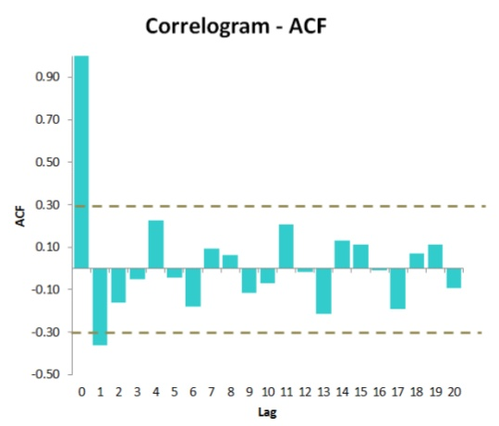
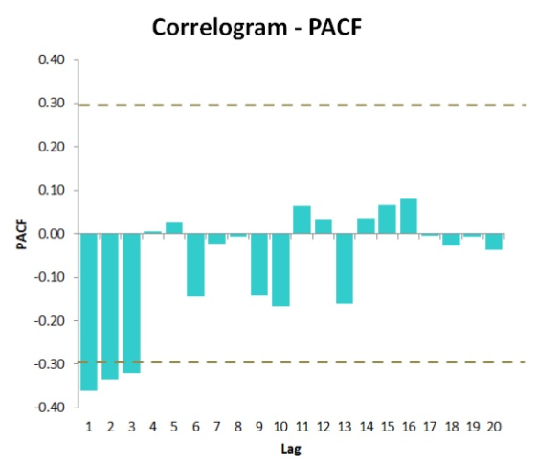
Model Selection Example of the Ages at Death of the Kings of England
An ARMA(0,1) model, that is, a moving average model of order q=1, since the auto-correlogram is zero after lag 1 and the partial auto-correlogram tails off to zero
an ARMA(3,0) model, that is, an autoregressive model of order p=3, since the partial auto-correlogram is zero after lag 3, and the auto-correlogram tails off to zero

Slide 22
Selecting a Candidate ARIMA Model
Which model is best: we assume that the model with the fewest parameters is best.
The ARMA(3,0) model has 3 parameters, and the ARMA(0,1) model has 1 parameter. Therefore, the ARMA(0,1) model is taken as the best model
then the original time series of the ages of death can be modelled using an ARIMA(0,1,1) model (with p=0, d=1, q=1, where d is the order of differencing required)

Slide 23
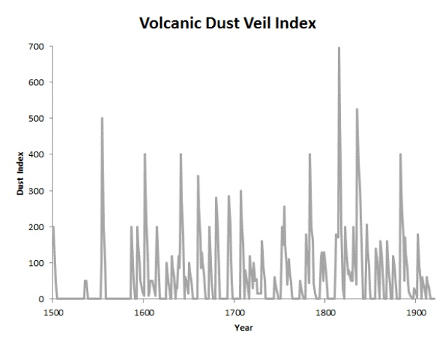
Another Example
The volcanic dust veil index data in the northern hemisphere, from 1500-1969 (original data from Hipel and Mcleod, 1994). This is a measure of the impact of volcanic eruptions’ release of dust and aerosols into the environment.
The time series appears to be stationary in mean and variance, as its level and variance appear to be roughly constant over time.
Therefore, we do not need to difference this series in order to fit an ARIMA model, (the order of differencing required, d, is zero here).

Slide 24
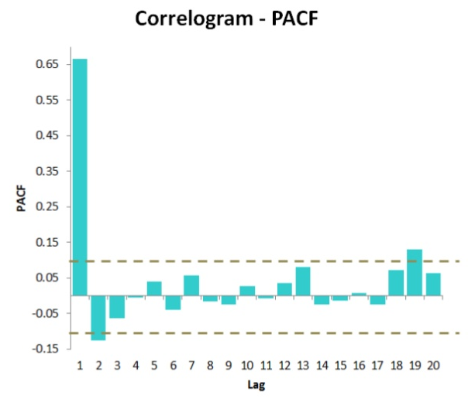
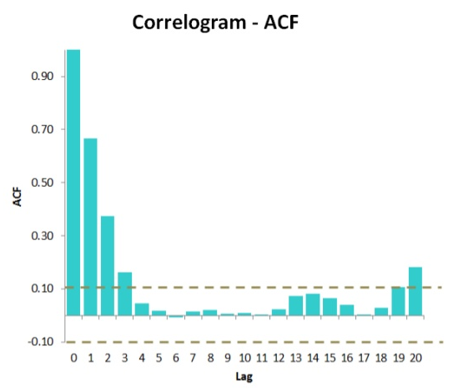
Selecting a Candidate ARIMA Model
an ARMA(0,3) model, since the auto-correlogram is zero after lag 3, and the partial correlogram tails off to zero (although perhaps too abruptly for this model to be appropriate)
an ARMA(2,0) model, since the partial auto-correlogram is zero after lag 2, and the correlogram tails off to zero after lag 3, and the partial correlogram is zero after lag 2

Slide 25
MA vs AR
A MA (moving average) model is usually used to model a time series that shows short-term dependencies between successive observations. Intuitively, it makes good sense that a MA model can be used to describe the irregular component in the time series of ages at death of English kings, as we might expect the age at death of a particular English king to have some effect on the ages at death of the next king or two, but not much effect on the ages at death of kings that reign much longer after that.
An AR (autoregressive) model is usually used to model a time series which shows longer term dependencies between successive observations. Intuitively, it makes sense that an AR model could be used to describe the time series of volcanic dust veil index, as we would expect volcanic dust and aerosol levels in one year to affect those in much later years, since the dust and aerosols are unlikely to disappear quickly.

Slide 26
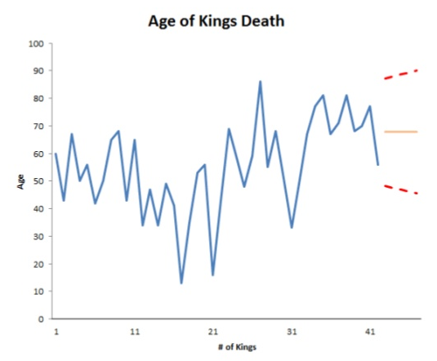
Forecasting Using ARIMA
We can plot the observed ages of death for the first 42 kings, as well as the ages that would be predicted for these 42 kings and for the next 5 kings using our ARIMA(0,1,1) model, by typing
it is a good idea to investigate whether the forecast errors of an ARIMA model are normally distributed with mean zero and constant variance.

Slide 27
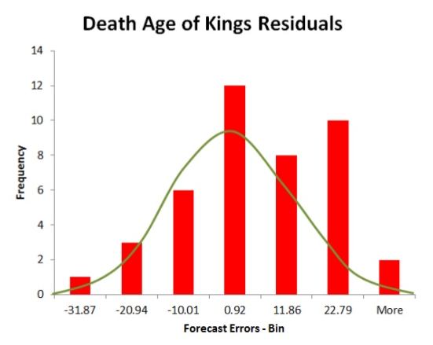
Statistical Test to Improve the Model
The histogram of the time series shows that the forecast errors are roughly normally distributed and the mean seems to be close to zero.
Therefore, it is plausible that the forecast errors are normally distributed with mean zero and constant variance.
Conclusion: the ARIMA(0,1,1) does seem to provide an adequate predictive model for the ages at death of English kings.

Slide 28
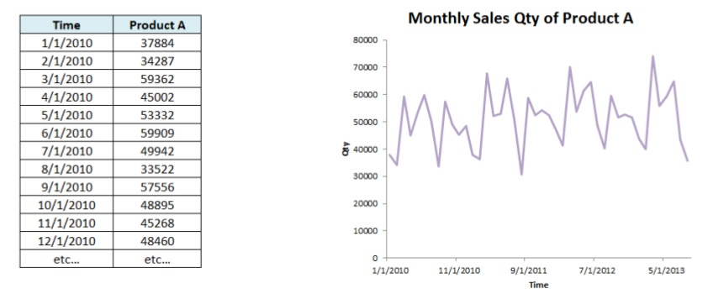
Example: Product Sales Quantity
What does the time series graph show us in terms of the modeling technique to use?
Is there a trend? If so, is there any direction?
Is there seasonality?
Which potential model(s) would you use for this application?
ARIMA(p, d, q)

Slide 29
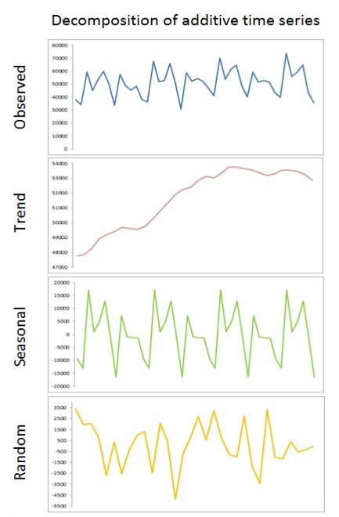
Decompose the Time Series
In order to further isolate the algorithm to use for analysis, lets decompose the time series to see the individual components.
There appears to be a slight positive trend line
There is a regular seasonal component to the data.
Finally, the random component of the data reaches peaks of 3500 units and troughs of - 4500 units. The gap of this spread is wide enough that we should use an ARIMA(p, d, q) model in order to capture this noise in our final analysis.

Slide 30
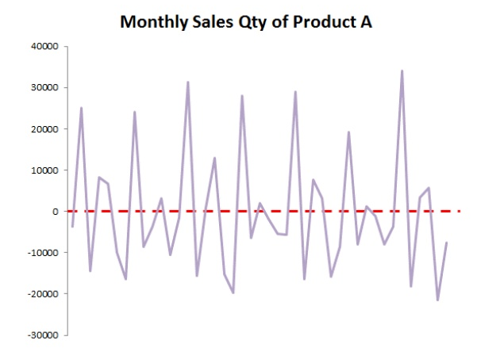
Differencing the Time Series
The time series of first difference does appear to be stationary in mean and variance.
Since we had to difference the time series once, and so the order of differencing (d) is 1. This means that you can use an ARIMA(p,1,q) model for your time series.
The next step is to figure out the values of p and q for the ARIMA model.
Difference = 1

Slide 31
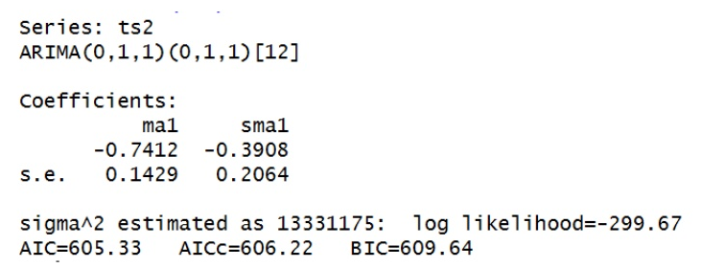
Statistical Test to Improve the Model
There is a technique in R called auto.arima() which will identify the best candidate ARIMA(p,d,q) based upon some evaluation parameters (default is Akaike Information Criterion or AIC).
When we process this technique the resulting model is an ARIMA(0,1,1).

Slide 32
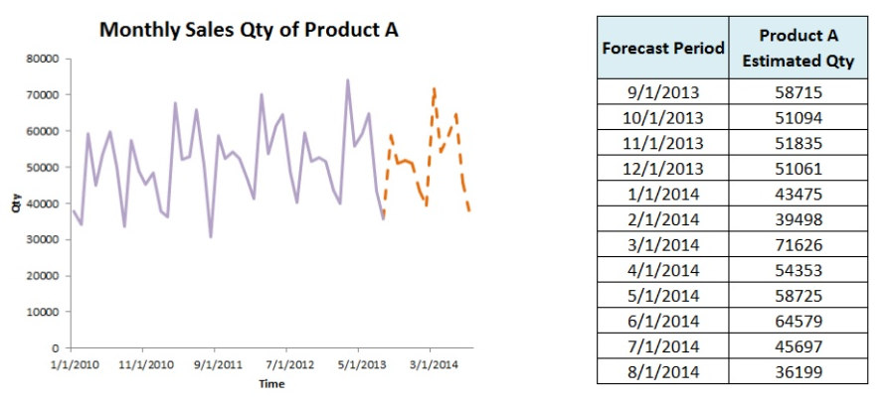
Forecasting the Results
We specified that the forecast extends for t=12 or 12 months. The final forecast takes into consideration seasonal variations, evolving macro/micro trends, and leverages the random noise when building the quantity estimates

Slide 33
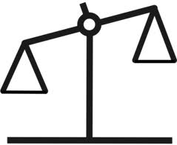
Time Series Analysis - Reasons to Choose (+) & Cautions (-)
Reasons to Choose (+) | Cautions (-)
Minimal data collection Only have to collect the series itself Do not need to input drivers | No meaningful drivers: prediction based only on past performance No explanatory value Can't do "what-if" scenarios Can't stress test
Designed to handle the inherent autocorrelation of lagged time series Compared to simple linear regression Once you've seasonally/trend adjusted | It's an "art form" to select appropriate parameters
 | Suitable for short term predictions only
Notes:
The Reasons to Choose (+) and Cautions (-) of Time Series Analysis are listed.
Time Series Analysis is not a common “tool” in a Data Scientist’s tool kit. Though the models require minimal data collection and handle the inherent auto correlations of lagged time series, it does not produce meaningful drivers for the prediction.
The selection of (p,d,q) appropriately is not very straight forward. A complete understanding of the domain knowledge and very detailed analysis of trend and seasonality may be required. Further this method is suitable for short term predictions only.

Slide 34
Time Series Analysis with R
Getting the data and plotting
The function “ts” is used to create time series objects
Made into an R time series via
mydata.data<- ts(mydata,start=c(1999,1),frequency=12)
Model building – use plot and box plot
Differencing
diff(hstart.data,1,1)
acf: It computes (and by default plots) estimates of the autocovariance or autocorrelation function
pacf: It is the function used for the partial autocorrelations
Notes:
Important R functions and commands we will be using are listed here.

Slide 35
Time Series Analysis with R (Continued)
arima: Fit an ARIMA model to a Univariate Time Series
predict: Do model predictions
“predict” is a generic function for predictions from the results of various model fitting functions. The function invokes particular methods which depend on the class of the first argument
decompose:
Decompose a time series into seasonal, trend and irregular components using moving averages
Deals with additive or multiplicative seasonal component
stl: Decompose a time series into seasonal, trend and irregular components using loess
auto.arima() which will identify the best candidate ARIMA(p,d,q) based upon some evaluation parameters (default is Akaike Information Criterion or AIC).
Notes:
Some additional commands in the ts package are listed.
We will use these commands in the lab.

Slide 36
Tractor-Sales Example
#Load data from file
data<-read.csv("Tractor-Sales.csv");
# create a time series data
data<-ts(data[,2],start = c(2003,1),frequency = 12)
plot(data, xlab="Years", ylab = "Tractor Sales")
# try to make it stationary by diff once
plot(diff(data),ylab="Differenced Tractor Sales")
# diff once is not enough so try to diff the log
plot(log10(data),ylab="Log (Tractor Sales)")
plot(diff(log10(data)),ylab="Differenced Log (Tractor Sales)")

Slide 37
Tractor-Sales Example
#now fit an arima model
require(forecast)
# auto.arima decide the best model. trace=false to show only the simple model
ARIMAfit <- auto.arima(log10(data),approximation=FALSE,trace=FALSE)
summary(ARIMAfit)
#use the fitted model to predict next 3 years (too much)
pred <- predict(ARIMAfit, n.ahead = 36)
plot(data,type="l",xlim=c(2004,2018),ylim=c(1,1600),xlab = "Year",ylab = "Tractor Sales")
#plot the prediction and its +- 2 std dev. (expected error)
lines(10^(pred$pred),col="blue")
lines(10^(pred$pred+2*pred$se),col=“red")
lines(10^(pred$pred-2*pred$se),col=“red")
#Ŷt = Yt-12 + Yt-1 – Yt-13 - θ1 et-1 – Θ1 et-12 + θ1 Θ1 et-13
# θ1 is ma1 and Θ1 is sma1 (seasonal moving average)

Slide 38
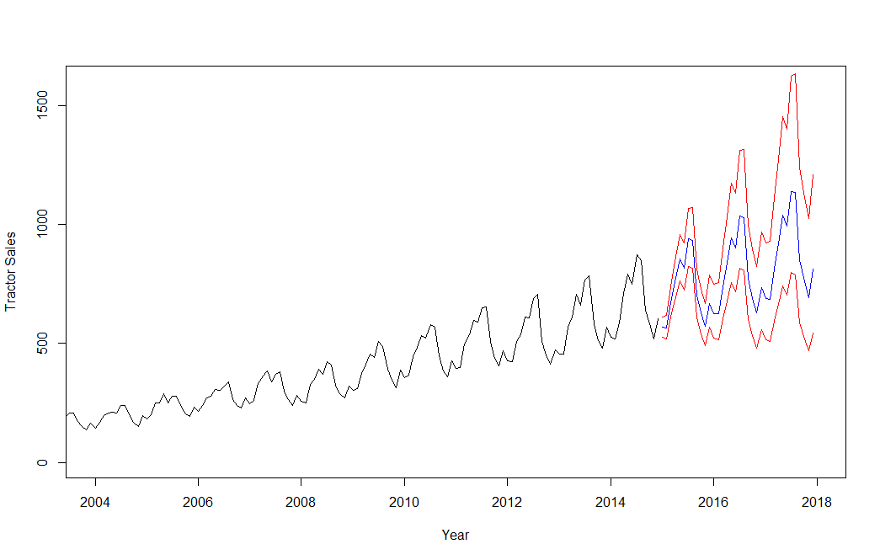
Tractor Sales Forecasting

Slide 39
Tractor-Sales Example
# In the forecast package, you can do the log transformation
# inside the auto.arima() function
# The lambda indicates a Box-Cox transformation and
# lambda=0 corresponds to a logarithm.
# The forecast function will recognize that a log has been
# applied and back-transform the forecasts appropriately.
ARIMAfit <-auto.arima(data,lambda=0,approximation=FALSE,trace=FALSE)
summary(ARIMAfit)
plot(forecast(ARIMAfit),xlim=c(2004,2018),ylim=c(1,1600),xlab = "Year",ylab = "Tractor Sales")

Slide 40
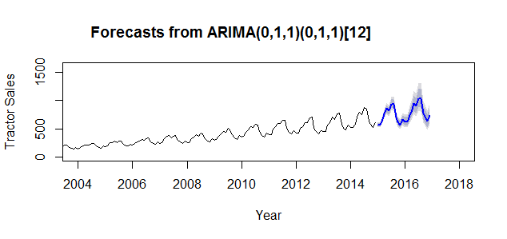
Tractor Sales Forecasting

Slide 41
Check Your Knowledge
What is a time series and what are the key components of a time series?
How do we “de-trend” a time series data?
What makes data stationary?
How is seasonality removed from the data?
What are the modeling parameters in ARIMA?
How do you use ACF and PACF to determine the “stationarity” of time series data?
Notes:
Record your answers here.

Slide 42
Time Series Analysis - Summary
Time Series Analysis and its applications in forecasting
Time Series Decomposition
ARIMA Model
Reasons to Choose (+) and Cautions (-) with Time Series Analysis
Time Series Analysis with R
Notes:
This lesson covered these topics. Please take a moment to review them.

